Slide 1
Ebooks recommendation system using reviewer ratings & Feedback
STUDENT DETAILS
K.Sasi Kiran
2019202049
GUIDE DETAILS
Ms.S.Kanimozhi,
Teaching Fellow

Slide 2
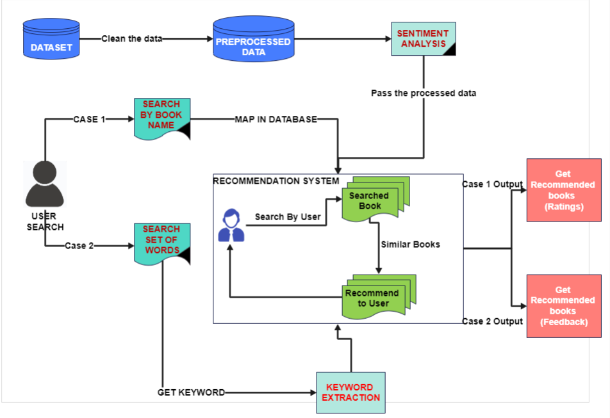
OVERALL ARCHITECTURE

Slide 3
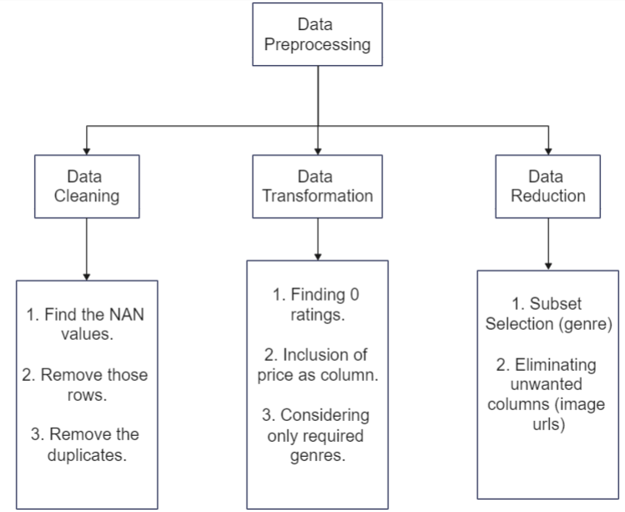
List of Modules
Data Preprocessing :
Input : All three (Books, Users, Ratings) CSV files.
Process the data, manipulate it, clean it using Pandas, Numpy in jupyter platform.
Output : Cleaned and processed Data which is loaded into another CSV file

Slide 4
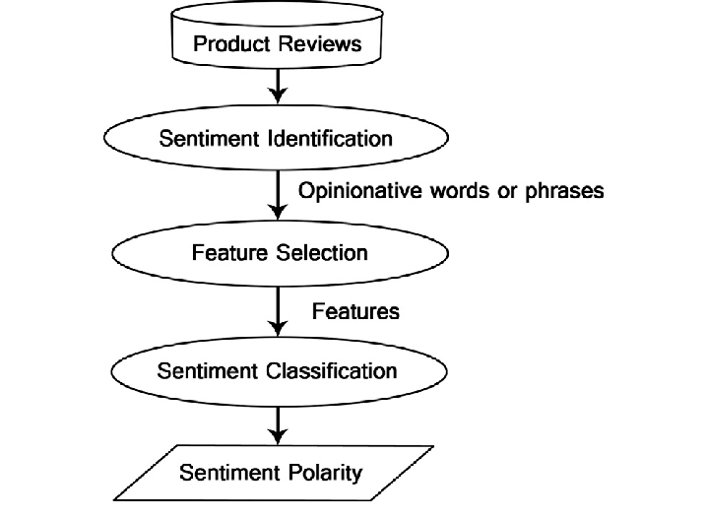
Sentiment Analysis:
Input : The preprocessed csv file.
Import nltk sentiment vader library and loop the column for which the polarity needs to be given to. The polarity is found for positivity, neutral and negativity for the feedback column and combined with the csv file with respect to the User-ID.
Output : The polarities for each column is found and they’re included in the dataset, i.e. compound, positive, neutral and negative columns

Slide 5
Search by name
Input : The user gives any keyword as input
The keyword is parsed to the recommendation system and similar type of books are recommended based on ratings.
Output : The recommended books are displayed in the order of ratings.
KEYWORD
Keyword is parsed
RS
Similar books
Recommended books (order by ratings)

Slide 6
Search by set of words
Input : The user gives set of words as input
The set of words is parsed, relevant word is taken and if matches with the genre, it is then parsed to the recommendation system.
Output : The recommended books are displayed in the order of positivity rate of the feedback.
Set of Words
Set of words is parsed to get relevant word
Match keyword
RS
Recommended books (order by feedback)

Slide 7
Search by name
Detailed description :
In this module, the user enters a keyword for example : good, true, story, best etc.
These keywords are made sure they are present in the features/description of the books.
They’re matched and parsed into the recommendation system.
The similar kind of books are displayed based on the order of ratings.

Slide 8
Flow diagram
Get the keyword
Calculate similar item 1
Calculate similar item 2
Similar Item
Calculate nearest neighbour
Item recommended
Display them as order by ratings

Slide 9
Search by set of words
Detailed Description :
In this module, at first the user will enter a sentence for example : the best selling new romance books.
Then the sentence is parsed and when a word in the sentence matches with the genre, it then goes for recommendation.
The recommendation is then given based on the feedbacks i.e. the highest positive rate books are displayed first.

Slide 10
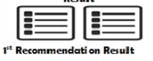

Flow diagram
1
Get the set of words
Match the keyword
Recommendation system
2
3
Collaborative filtering process
5
Result
4
Genre similarity
Result
Recommended books (display as order by feedback)
6
7

Slide 11

Module based outputs
Home page

Slide 12

1. Search by name
USER INPUT

Slide 13

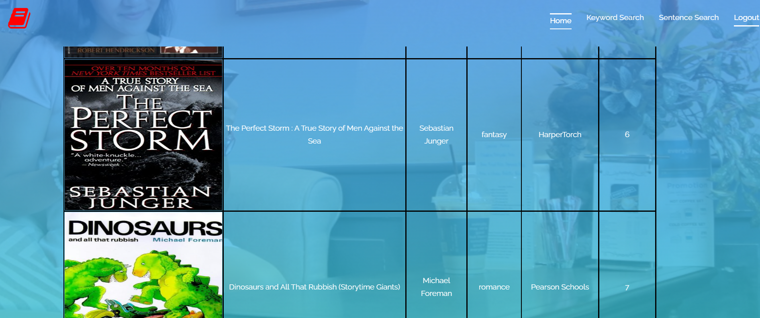
System Output

Slide 14

2. Search by set of words
USER INPUT

Slide 15
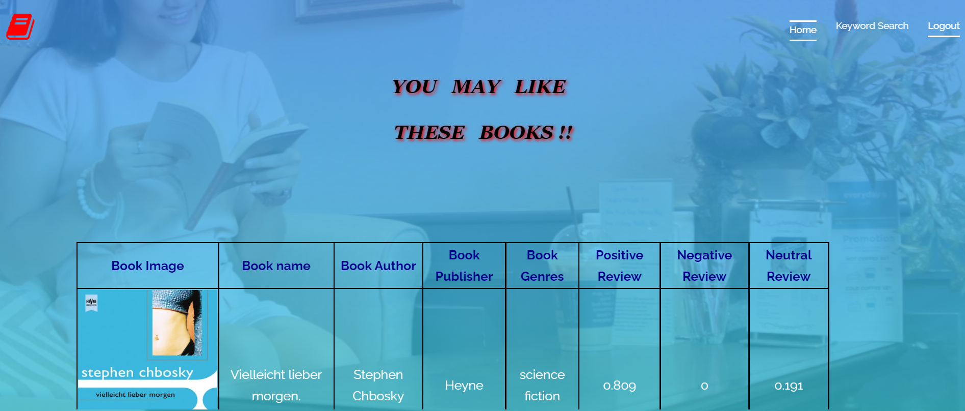
System Output

Slide 16
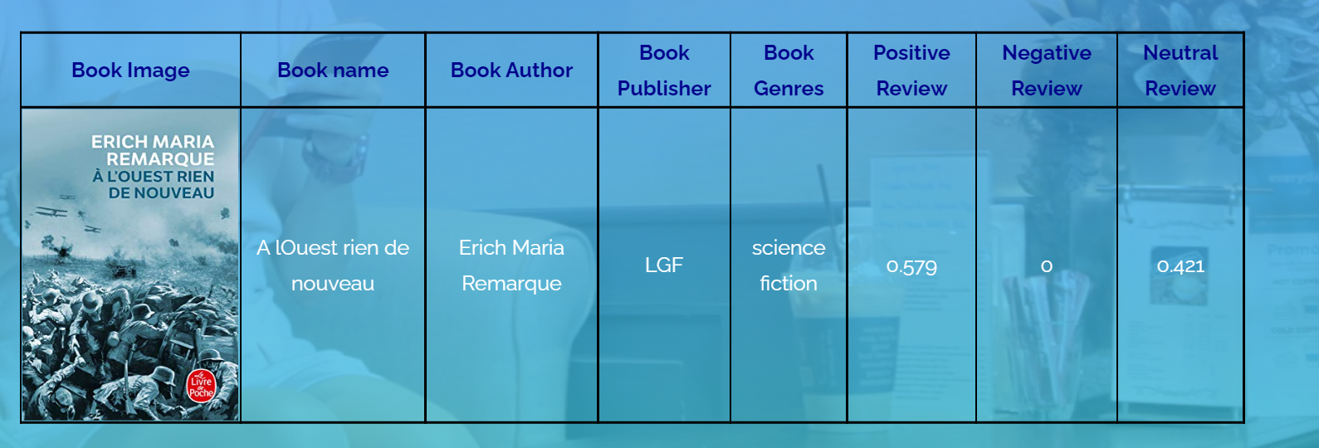
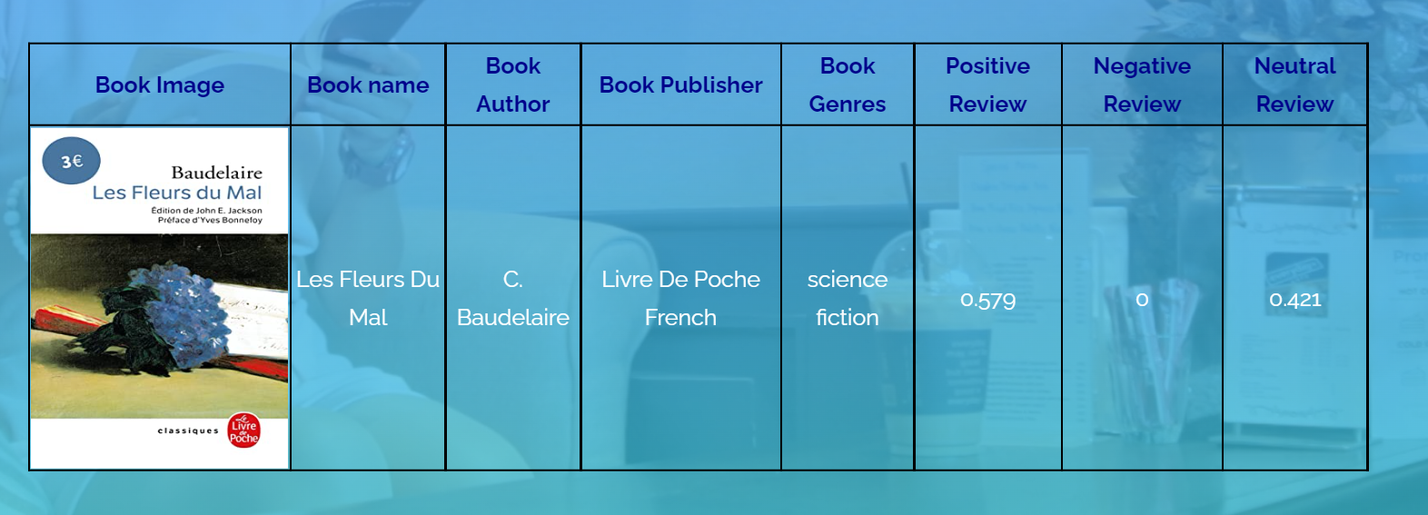

Slide 17
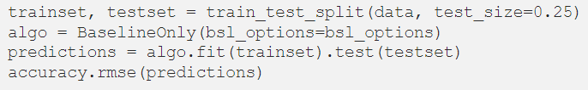
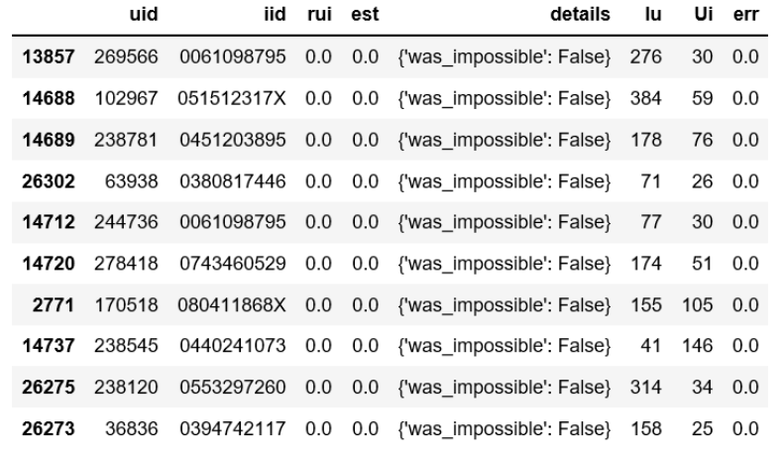
Testing
BaseLine Only
Best prediction (Before testing with BaseLine)

Slide 18
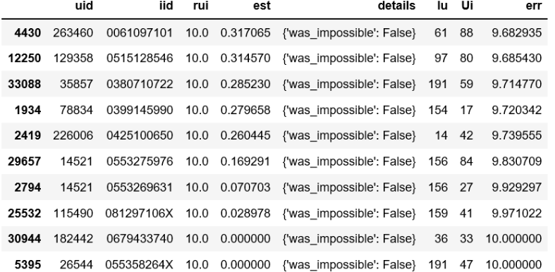
Worst prediction (After testing)
The worst predictions is giving new output. The last one ISBN “055358264X”. The book was rated by 47 users, user “26544” rated 10, our Baseline Only algorithm predicts this user would rate 0.

Slide 19
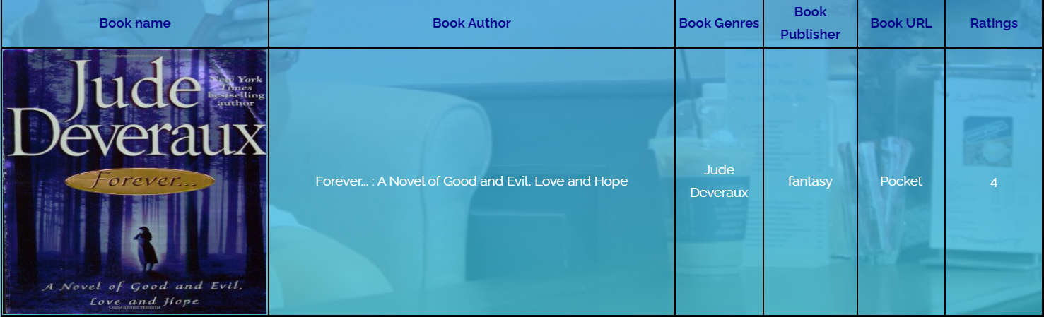
Test Cases (front end)
For search by keyword module
Case 1 : (if keyword present)
The books are recommended as per the item based collaborative filtering algorithm method

Slide 20
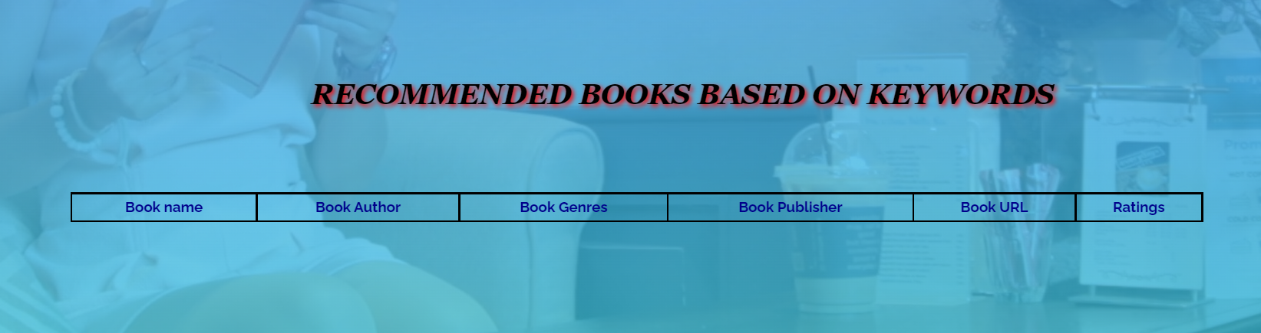
Case 2 : (if keyword not present)
No output is show, as there will be no books to recommend.

Slide 21
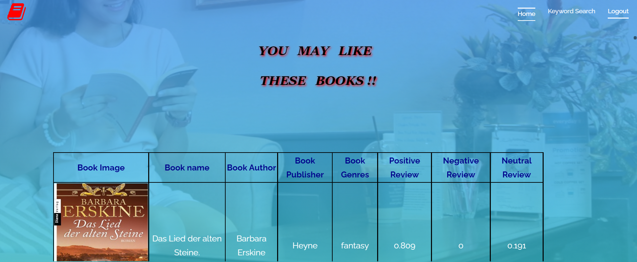
For Search by words module
Case 1 : (extraction of keyword is successful)

Slide 22
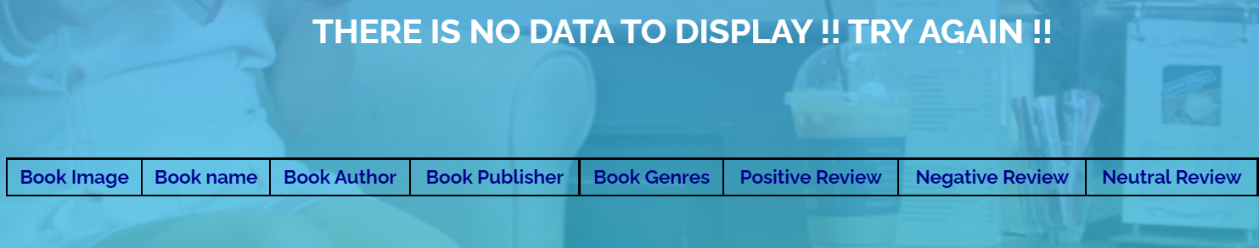
Case 2 : (extraction of keyword fails)
Error message is displayed

Slide 23
Experimental Analysis

